Slide 1
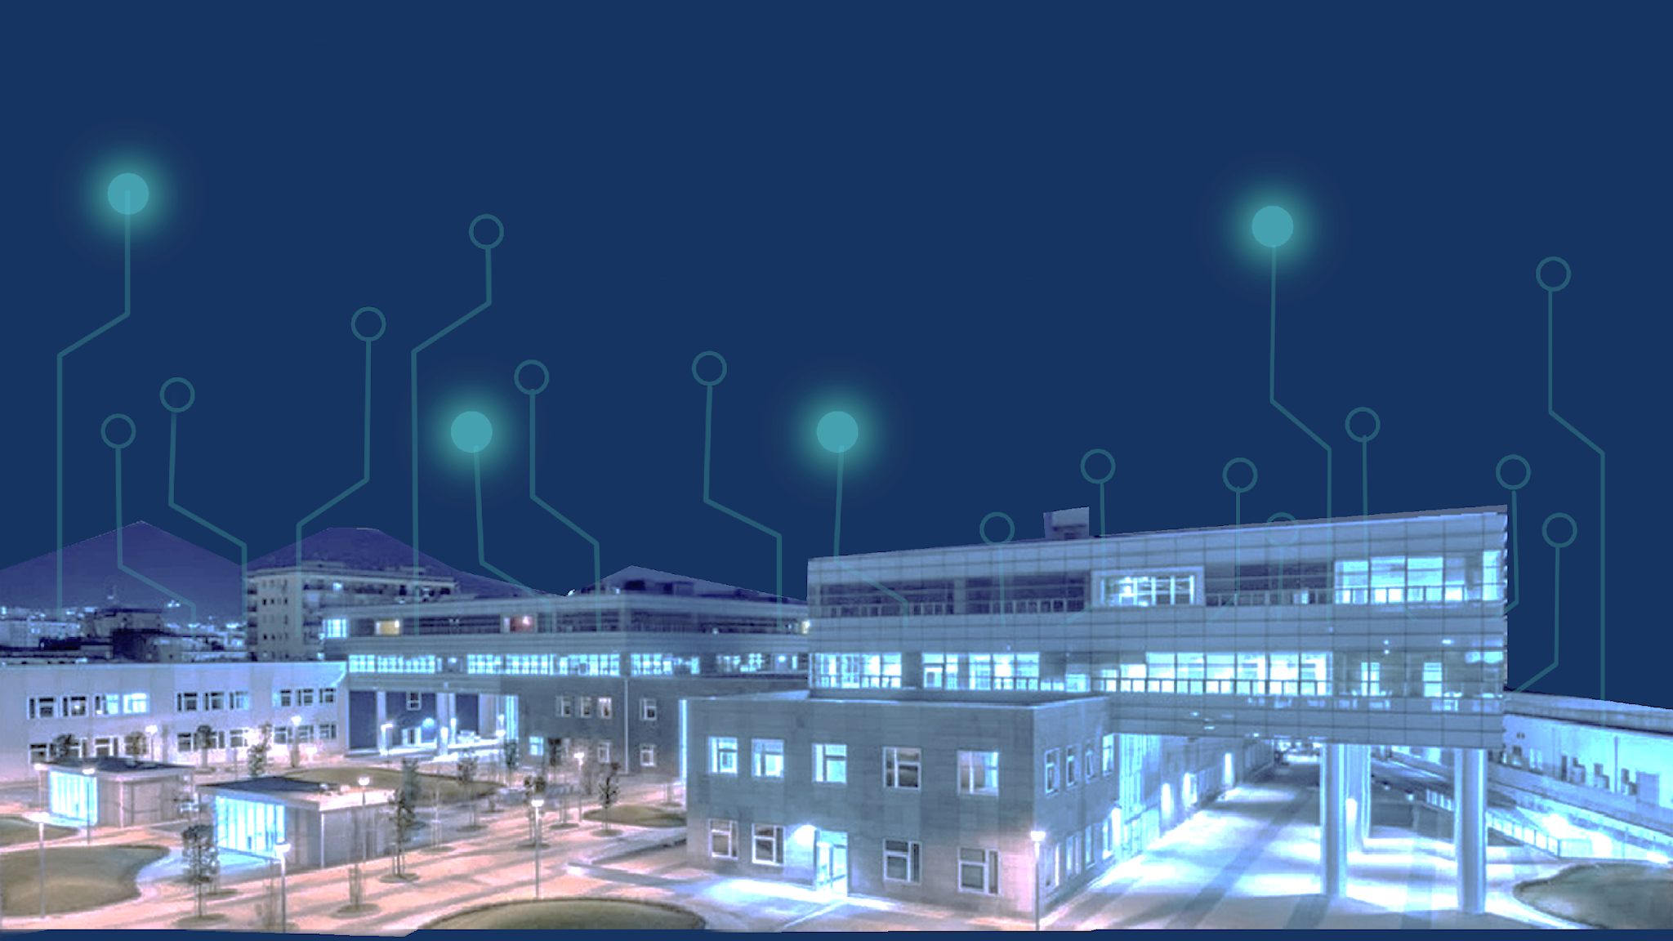

EDGE SYSTEM FOR SUSTAINABLE BUILDINGS

Slide 2




THE IDEA
‘’COMFORTABLE AND SAFE WORKPLACE
EVERY DAY
FOR EVERY SEASON’’
EDGE SYSTEM FOR SUSTAINABLE BUILDINGS
ENERGY MANAGEMENT
is a control and management system for workplace to improve environmental monitoring, energy efficiency, comfort and safety of indoor spaces with a focus on automating process and reducing risks.
SAFETY AND HEALTHY WORKSPACE
SUSTAINABILITY
CUSTOMIZED AUTOMATION SOLUTION

Slide 3




OBJECTIVES
SUCCESS
Reduce energy bills
Cost savings with process automation
IMPROVE YOUR BUSINESS
SUSTAINABILITY
Reduce energy consuming
Decrease CO2 emissions
Improve comfort and security of workplaces
STRATEGY
Predictive data of long term Analysis
Scalable design of project
EdgeofTomorrow Team

Slide 4

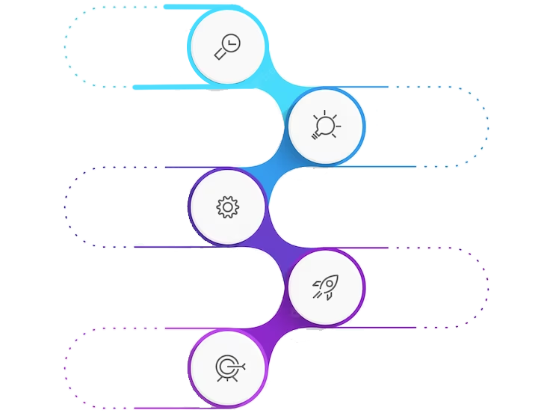


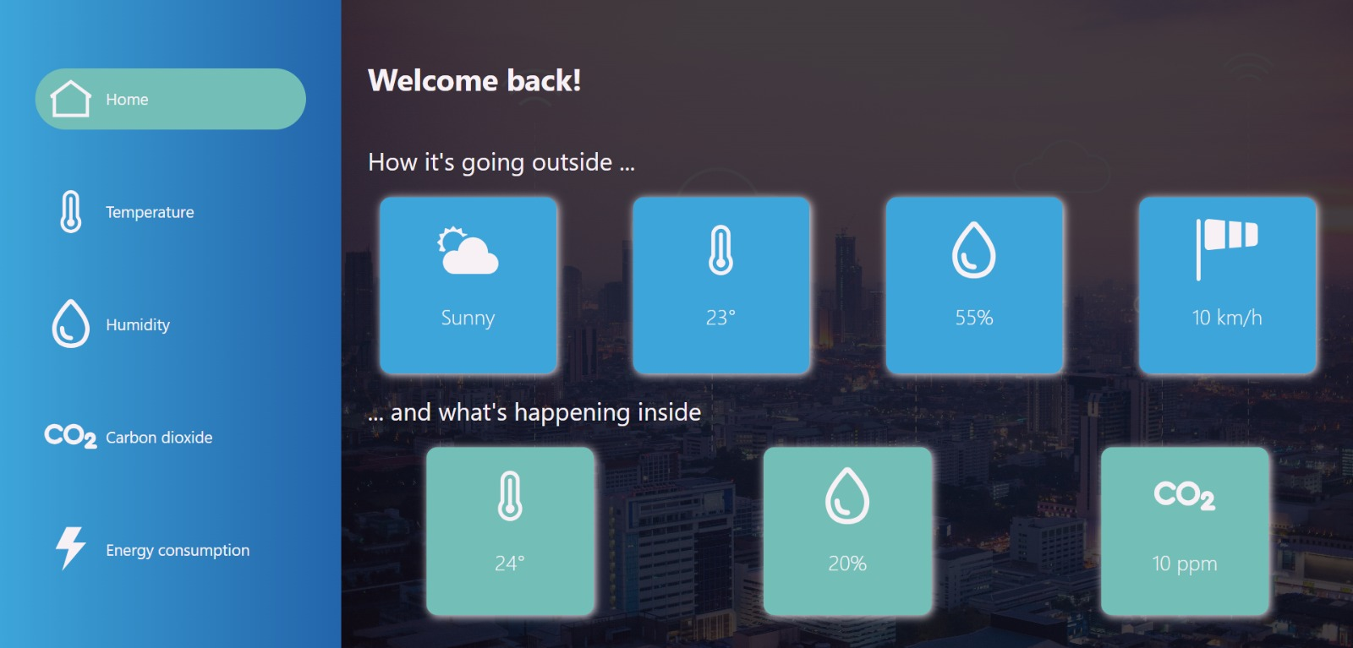



THE SOLUTION
PROBS & ACTUATORS
Cover the workspace in
order to aim an
always-on layer of
inspection.
MONITORING AND CONTROLLING
24/7 full control over each environmental parameters
EVENT AND RESPONSE
Every over-limit parameter
is notified to the user. Actuators optimize consumption and operation
REPORT AND ANALYSIS
User dashboard to check and manipulate data, generate reports and trigger actions
SCALABILITY
the system is adaptable to different types of indoor environments
EdgeofTomorrow Team

Slide 5

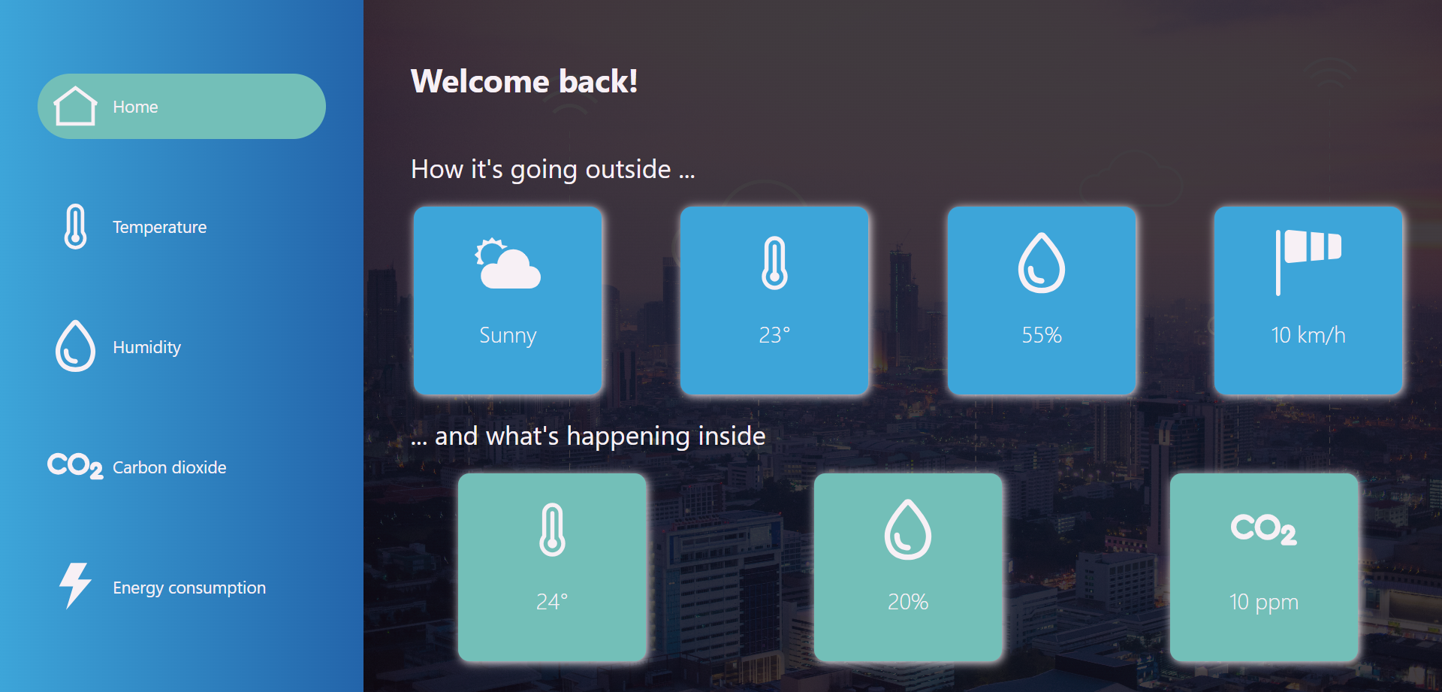
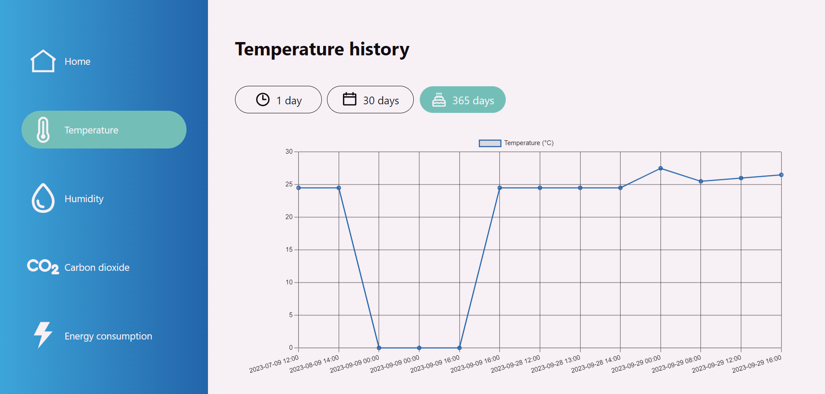
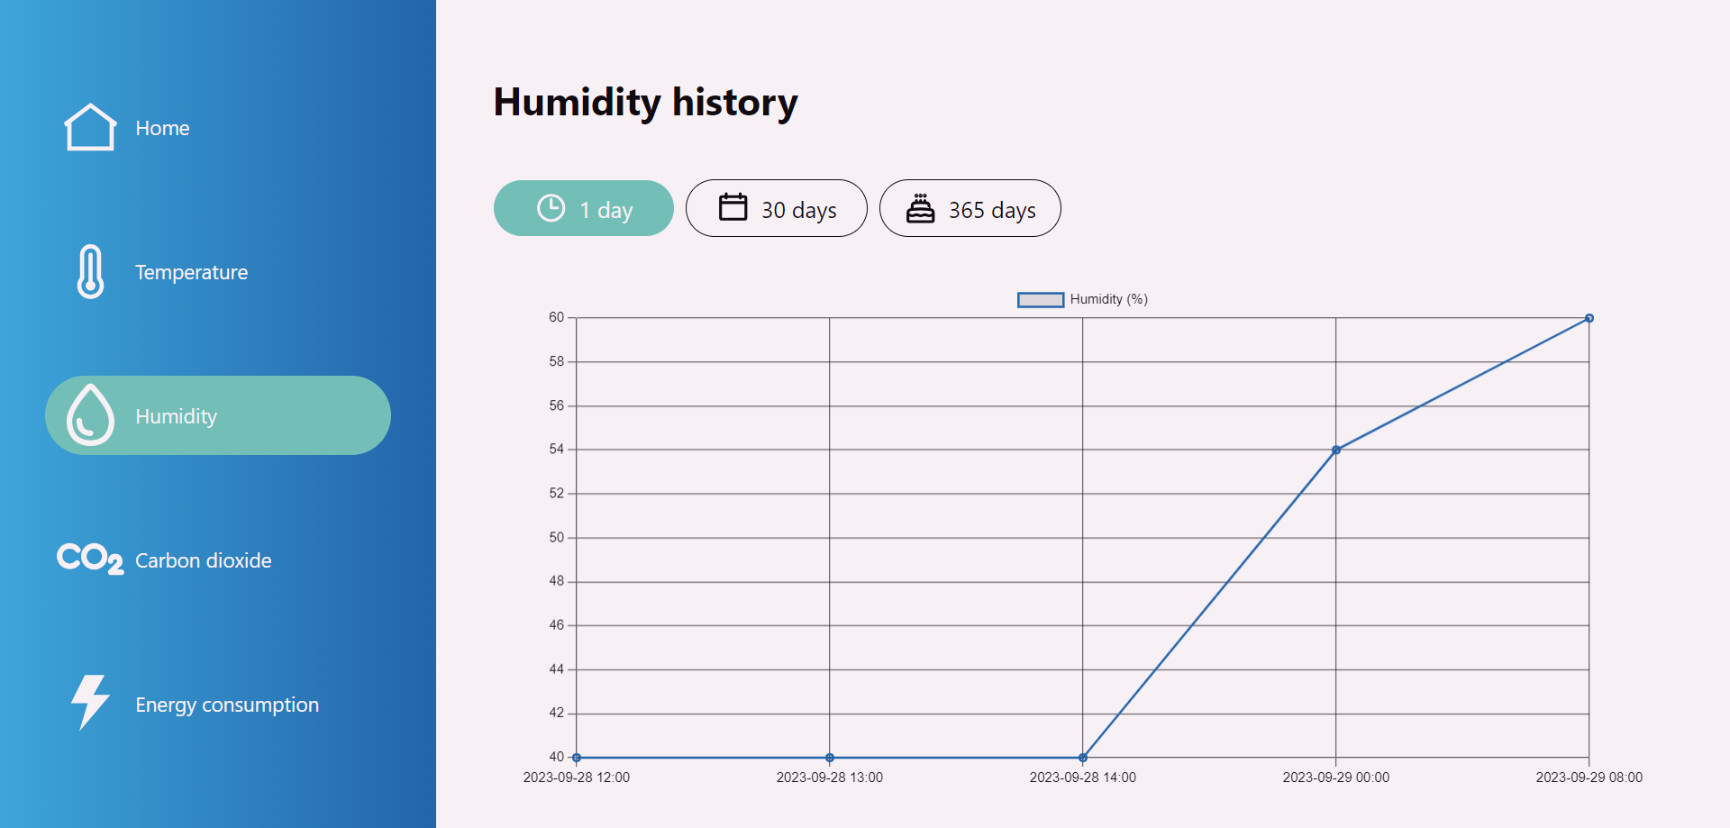
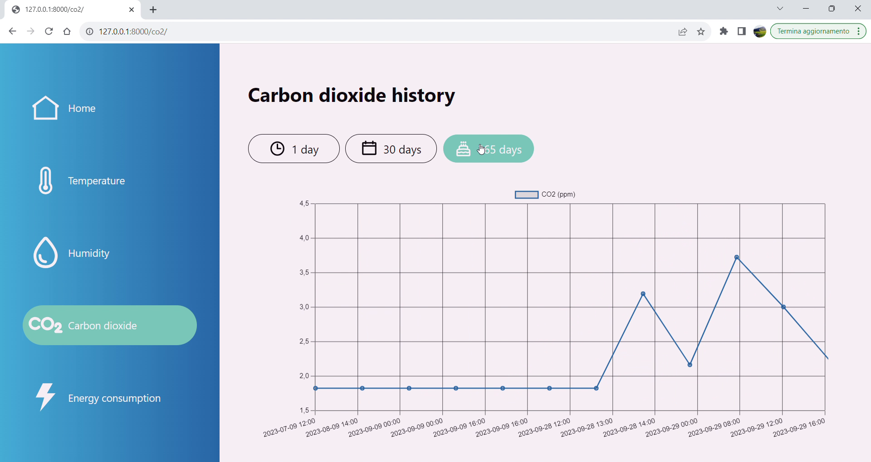
INTERFACE
EdgeofTomorrow Team

Slide 6
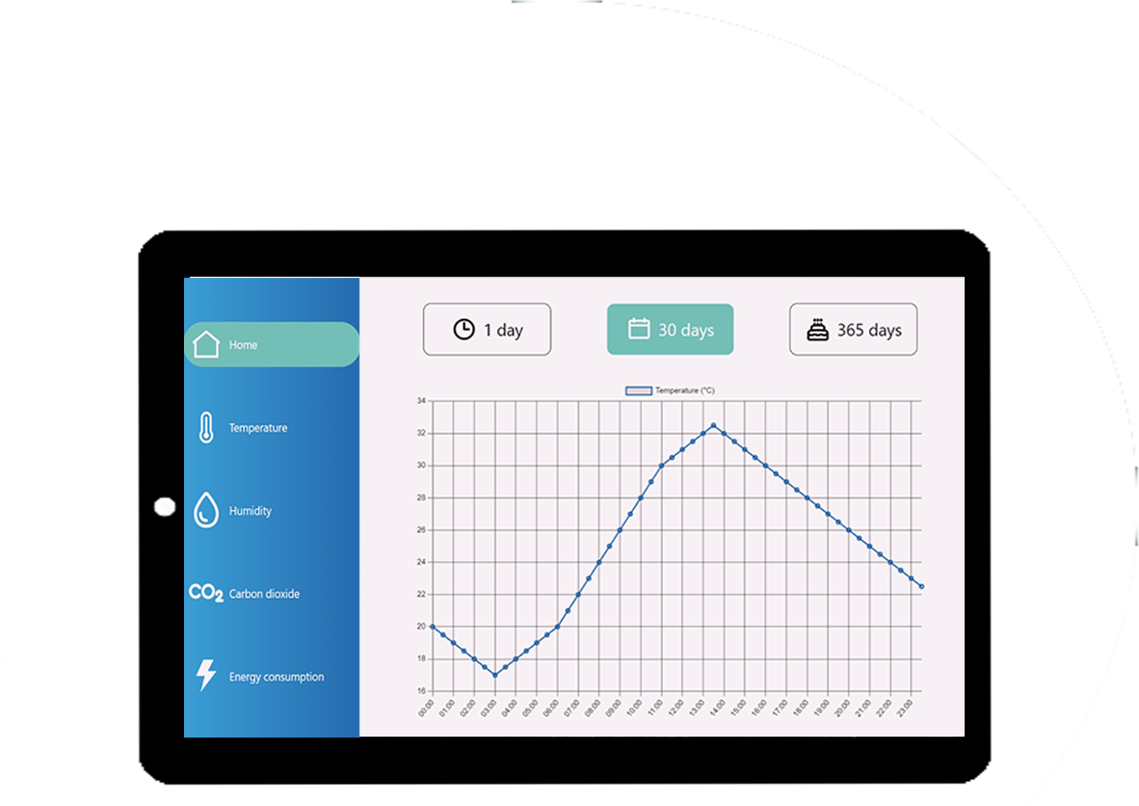
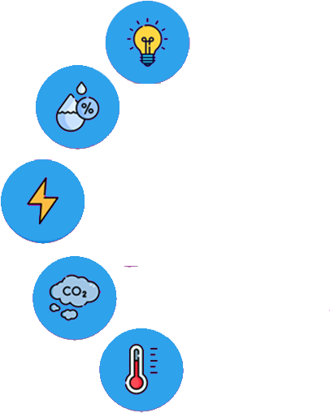
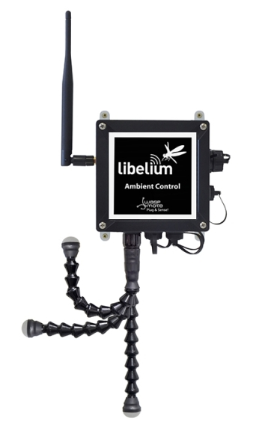
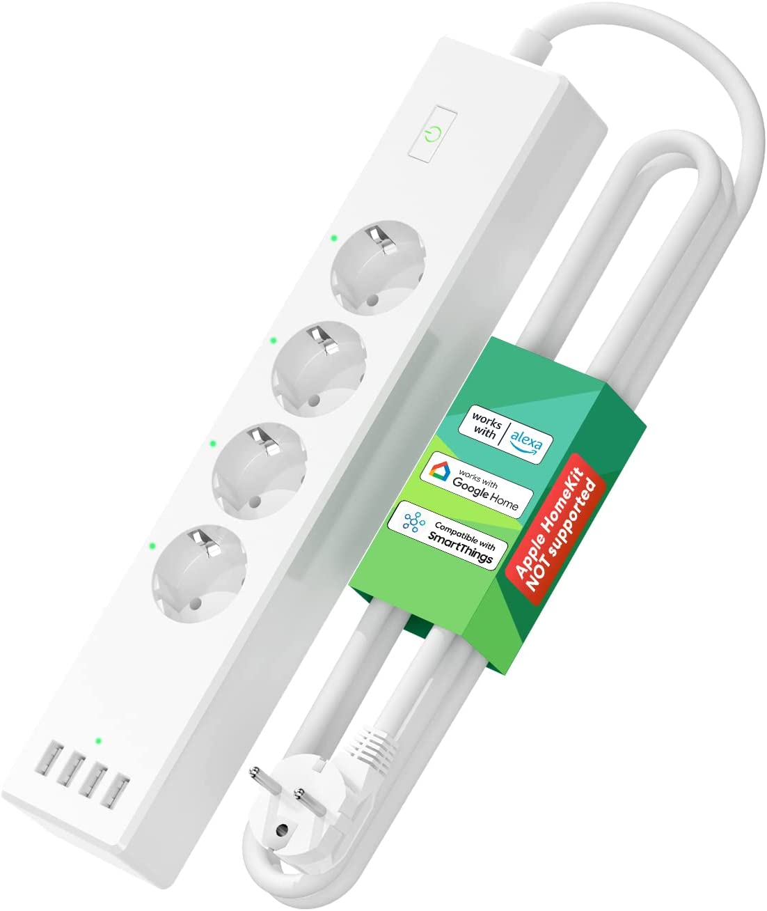

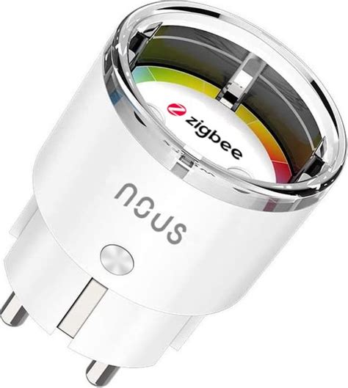

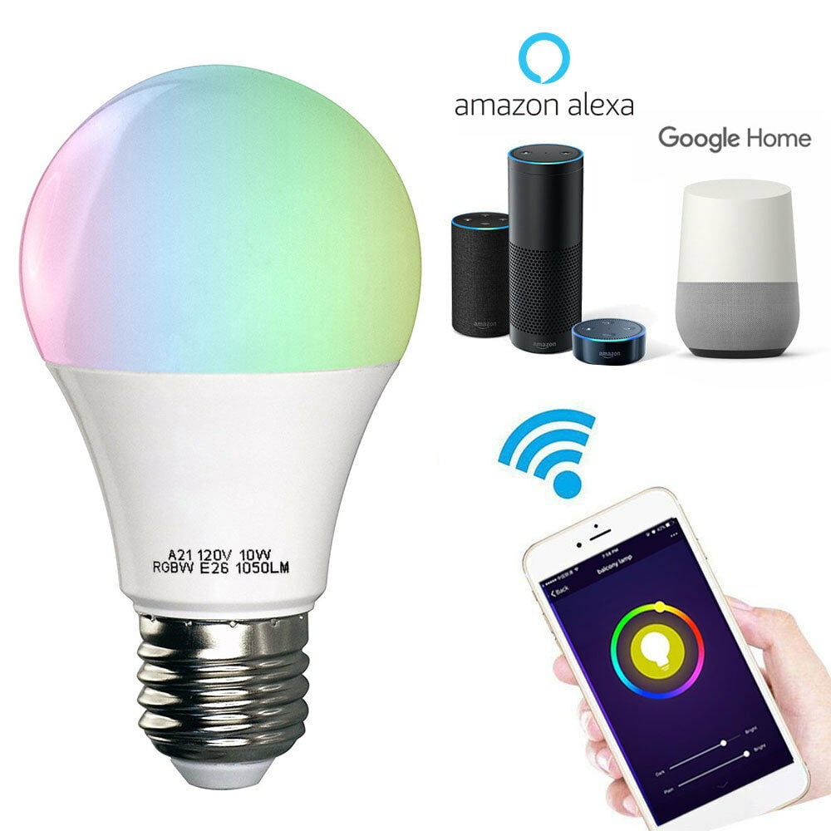


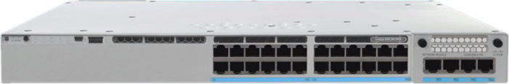
ARCHITECTURE
SENSORS
LIBELIUM ONE
ACTUATORS
Application on Cisco Container Platform
Python Edge Application
Statistic Dashboard
Control Dashboard
Database
Measurements collector
MQTTX broker
Actuators controller
EdgeofTomorrow Team
Cisco Catalyst 9300-24T switch

Slide 7


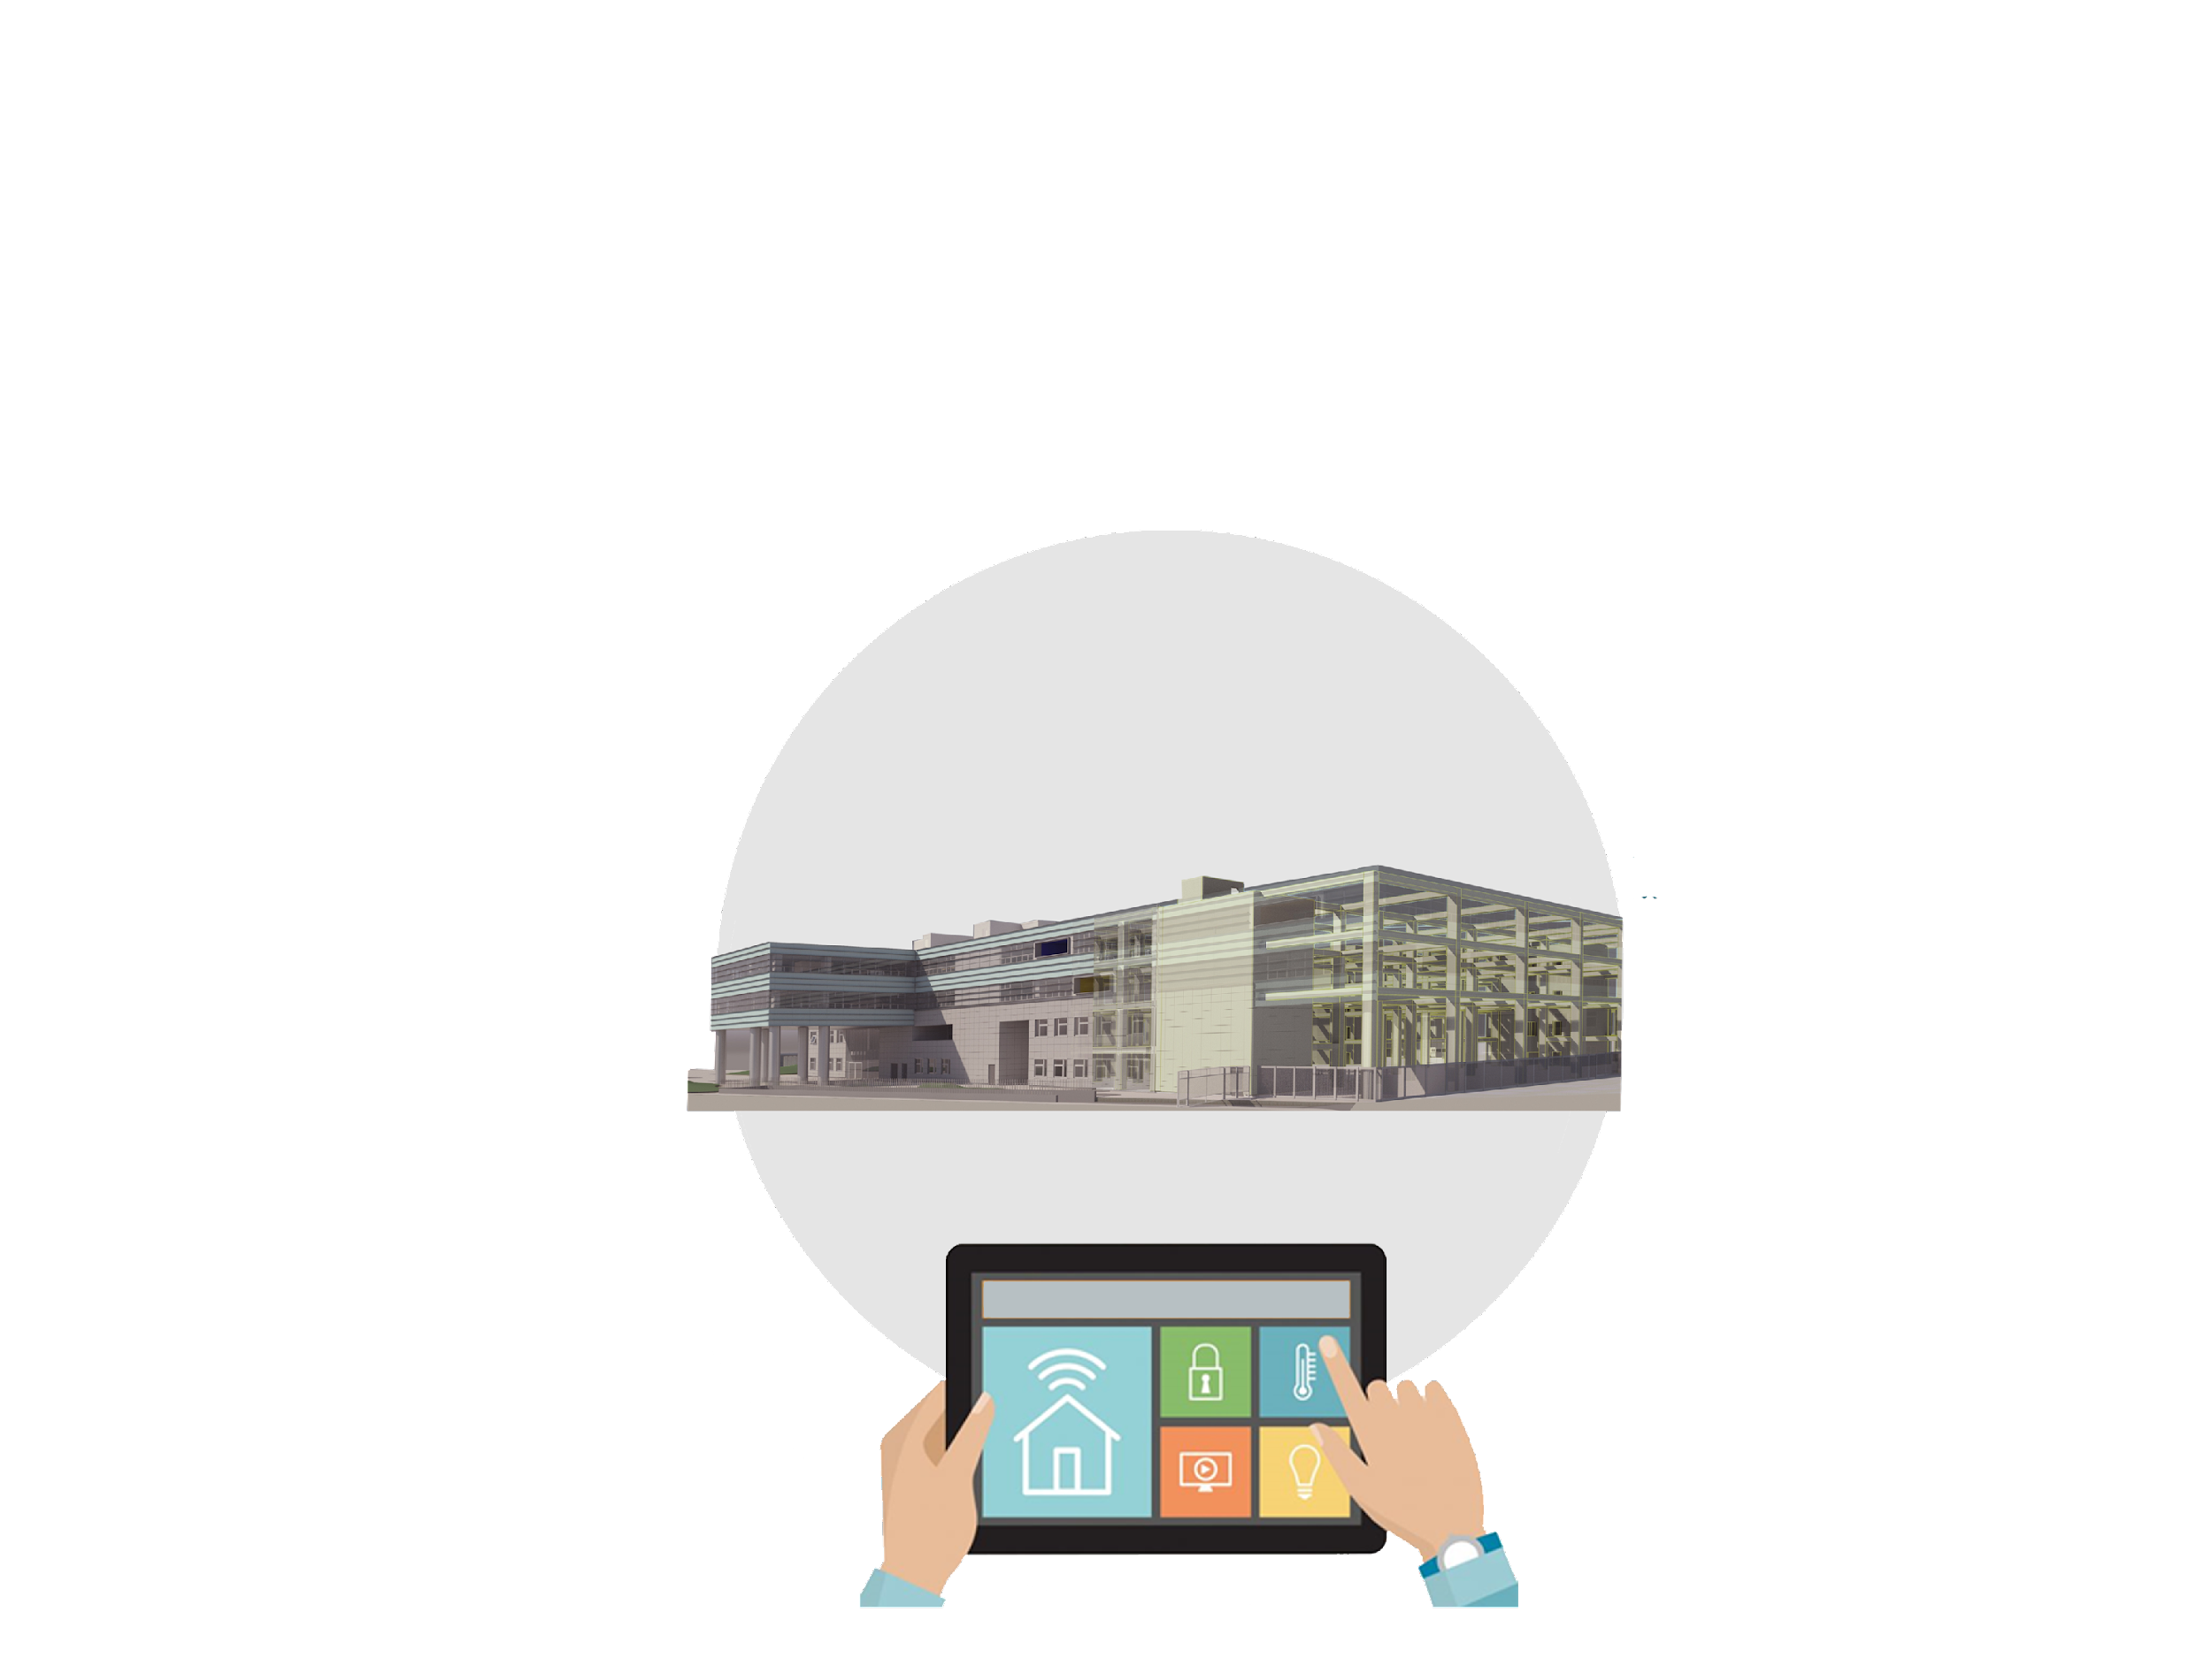
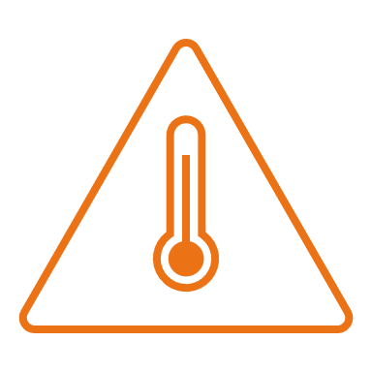









SERVICE DESCRIPTION
High Temperature Monitoring thermal comfort and saving energy cost
Smart Security Area
This system increases comfort through security cameras and lock door
Air Monitoring It works by giving an indication of how well-ventilated an area is, and the potential concentration of a virus in the atmosphere.
Humidity % Control
Appropriate humidity levels provide comfort and avoid risk viruses and germs to multiply
HVAC Smart Control
sets the temperature in individual rooms as response of different heating requirements
Smart lightning Light control means energy saving; smart lighting control system supports home security by providing increased protection
UNIVERSITÀ DI NAPOLI FEDERICO II
CAMPUS DI SAN GIOVANNI A TEDUCCIO

Slide 8





COSTS
10% reduction of C02 emissions*
Increases to 40% the energy savings*
Visualization Cloud Platform
HW Probes & Actuators
HW switch
Software licensing
Web app development, maintenance
Content management
38% reduction of electricity bills*
70-75% Breakdown Reduction
35-45% Reduced Downtime
25/30% Less Maintenance
BENEFITS
**https://www.researchgate.net/publication/340286656_Energy_Efficiency_in_Smart_Buildings_IoT_Approaches
EdgeofTomorrow Team

Slide 9



KEY TIMELINE GOALS
05
MILESTONE
System ON-AIR
04
MILESTONE
System Test
03
MILESTONE
Cloud Data Visualization
02
MILESTONE
HW Implementation
Sw Develop&Deployment
01
MILESTONE
Design Delivery
W1
W2
W3
W4
W1
W2
W3
W4
W1
W2
W3
W4
W1
W2
W3
W4
Month1
Month2
Month3
Month4
EdgeofTomorrow Team

Slide 10






EDGE OF TOMORROW TEAM
DARIO CANTELLA
ALESSANDRO COPPOLECCHIA
FILOMENA RAGONE
DANIELE FONTANA
FRANCESCO ALTIERO

Slide 11
THANK YOU FOR YOUR ATTENTION
... and now let's watch a video!

